Slide 1
DIABETES PREDICTION MASTER

Slide 2
Contents:
Abstract
Introduction
Existing System
Proposed System
Hardware Requirements
Software Requirements
Architecture Design
Procedure
Uml Diagrams
Coding
Output Screens
Results
Conclusion
References

Slide 3
Abstract:
The diabetes is one of lethal diseases in the world. It is additional a inventor of various varieties of disorders for example: coronary failure, blindness, urinary organ diseases etc.
In such case the patient is required to visit a diagnostic center, to get their reports after consultation. Due to every time they have to invest their time and currency.
But with the growth of Machine Learning methods we have got the flexibility to search out an answer to the current issue, we have got advanced system mistreatment information processing that has the ability to forecast whether the patient has polygenic illness or not.
Furthermore, forecasting the sickness initially ends up in providing the patients before it begins vital. Information withdrawal has the flexibility to remove unseen data from a large quantity of diabetes associated information.

Slide 4
Introduction:
Diabetes is an increasingly growing health issue due to inactive lifestyle.
If it is detected in time then through proper medical treatment, adverse effects can be prevented.
To help in early detection,machine learning technology can be used very reliably and efficiently.
So in this project, the objective is to predict whether the person has Diabetes or not using a machine learning model.
Here we will use the Pima Indians dataset from the UCI Machine learning repository for testing and training the model.
This dataset contains attributes like Blood pressure , preg, Insulin, Age, BMI etc.

Slide 5
Introduction:
The aim of this analysis ist o develop a system which might predict the diabetic risk level of a patient with a better accuracy. Model development is based on categorization methods as SVM algorithms .Our objective is to predict whether the patient has diabetes or not based on various features like Glucose level, Insulin, Age, BMI. We will perform all the steps
from Data gathering to Model deployment. During Model evaluation, we compare various machine learning algorithms on the basis of accuracy score metric and find the best one. Then we create a web app using Flask which is a python micro framework.

Slide 6
Existing System:
The aim of this analysis is to develop a system which might predict the diabetic risk level of a patient with a better accuracy. Model development is based on categorization methods as SVM algorithms .Our objective is to predict whether the patient has diabetes or not based on various features like Glucose level, Insulin, Age, BMI. We will perform all the steps
from Data gathering to Model deployment. During Model evaluation, we compare various machine learning algorithms on the basis of accuracy score metric and find the best one. Then we create a web app using Flask which is a python micro framework.

Slide 7
Proposed System:
The proposed system predicts the disease of diabetes in patients with maximum accuracy. We shall talk about various machine learning, the algorithm which can help in decision making and prediction. We shall use more than one algorithm to get better accuracy of prediction.
The disease dataset is given to the system which is then pre-processed so that the data is in a useable format for analysis. If the dataset is not structured or if the dataset is or if the dataset is huge or it has irrelevant features, we shall use feature extraction to extract the data. After this the data is trained and we apply a relevant machine learning algorithm to the dataset.

Slide 8
Hardware Requirements
Computer with i5 processor.
RAM of 4GB.
Hardisc(1TB).

Slide 9
Software Requirements
Python IDE.
Python pandas, sklearn libraries.
Python Numpy library.

Slide 10
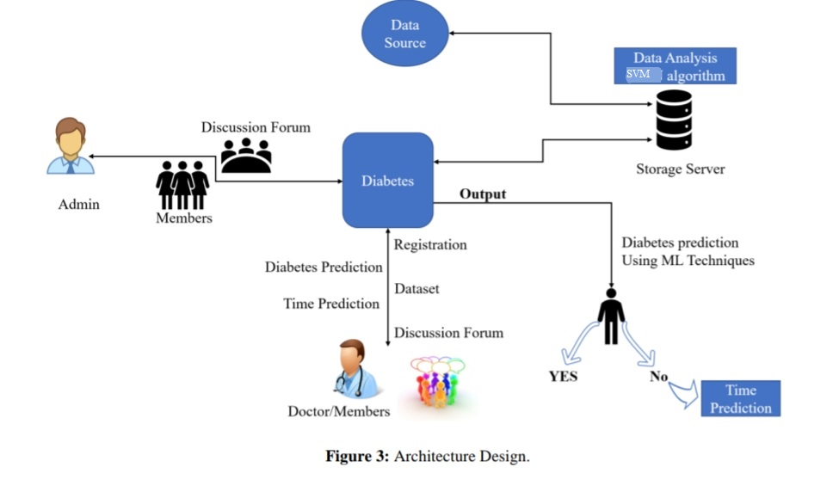
ARCHITECTURE:

Slide 11
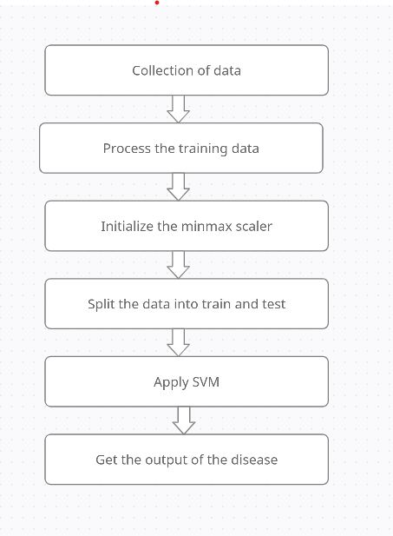
DATA FLOW:

Slide 12
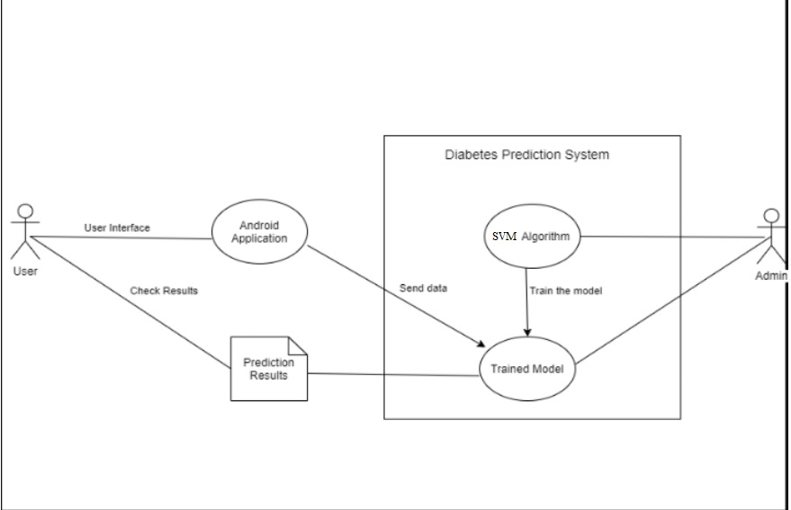
UML DIAGRAMS:

Slide 13
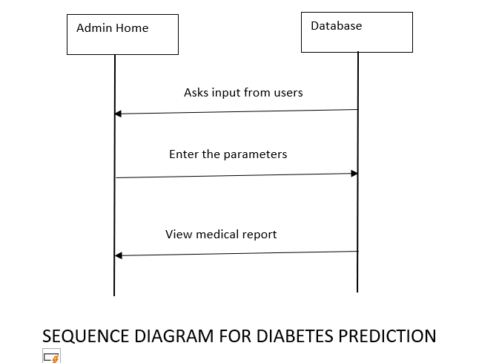

Slide 14
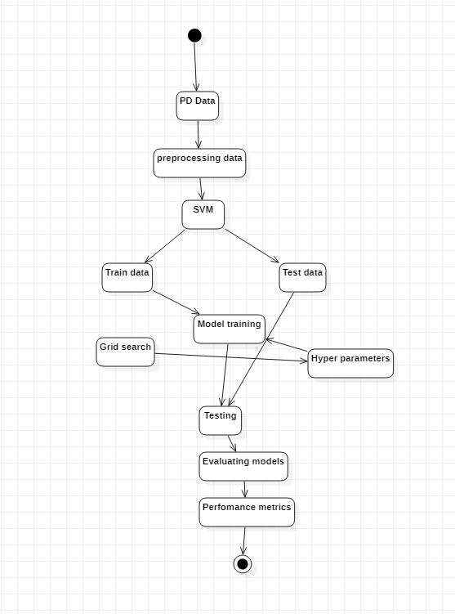

Slide 15
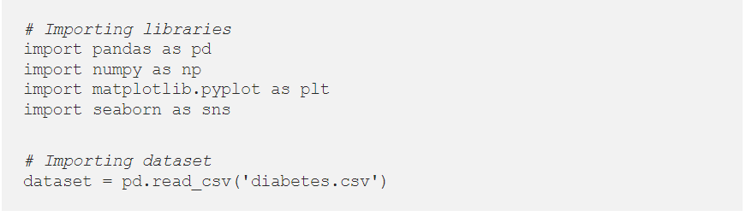
CODE:
Step 0: Data gathering and Importing libraries.

Slide 16
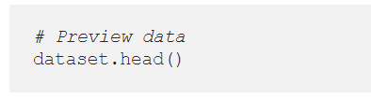
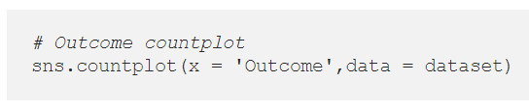
Step 1: Descriptive Analysis
Step 2: Data Visualizations

Slide 17
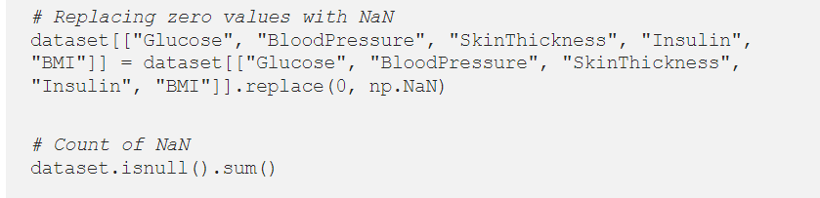
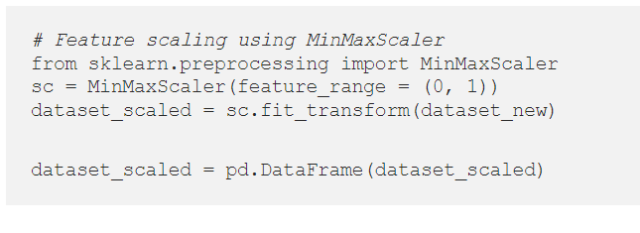
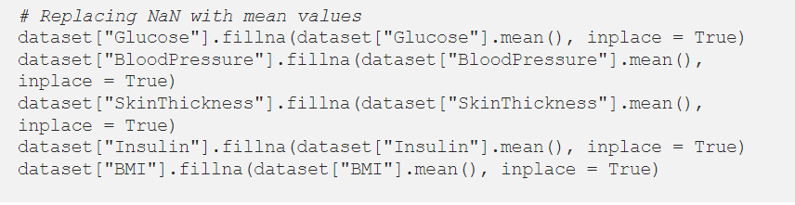
Step 3: Data Preprocessing

Slide 18
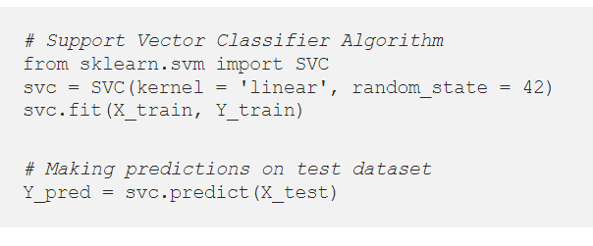
Step 4: Data Modelling

Slide 19
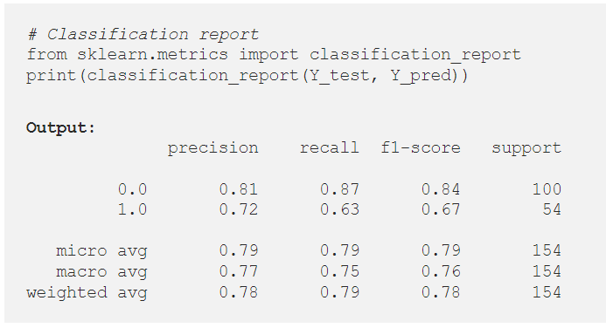
Step 5: Model Evaluation

Slide 20
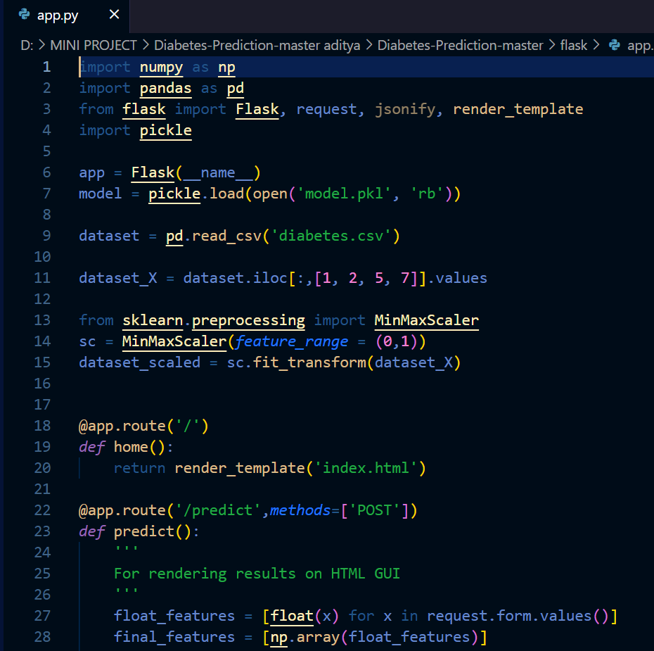

Slide 21
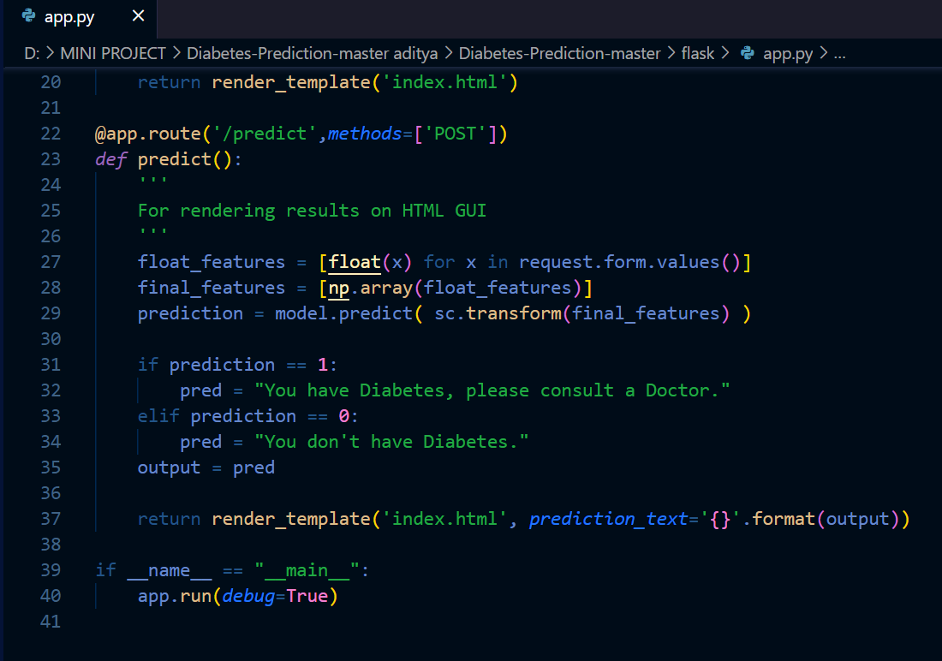

Slide 22
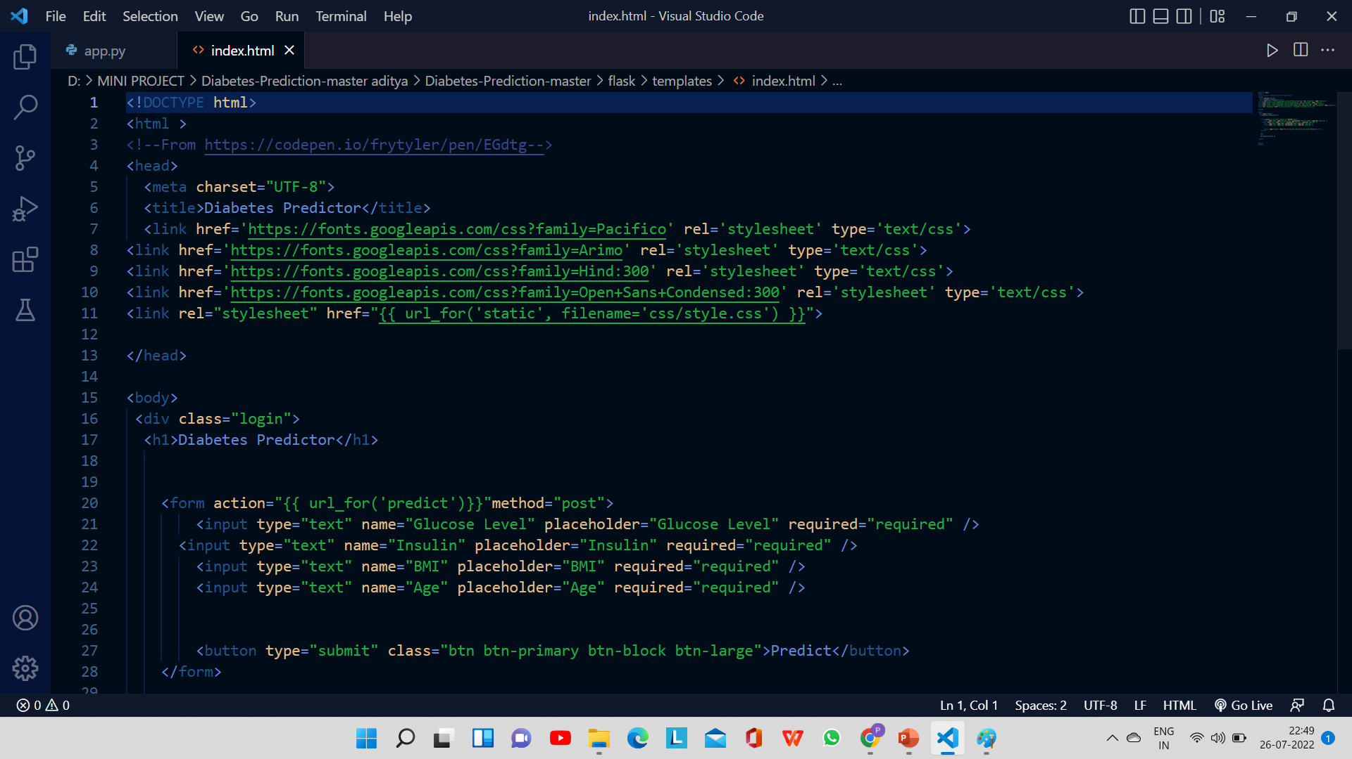

Slide 23
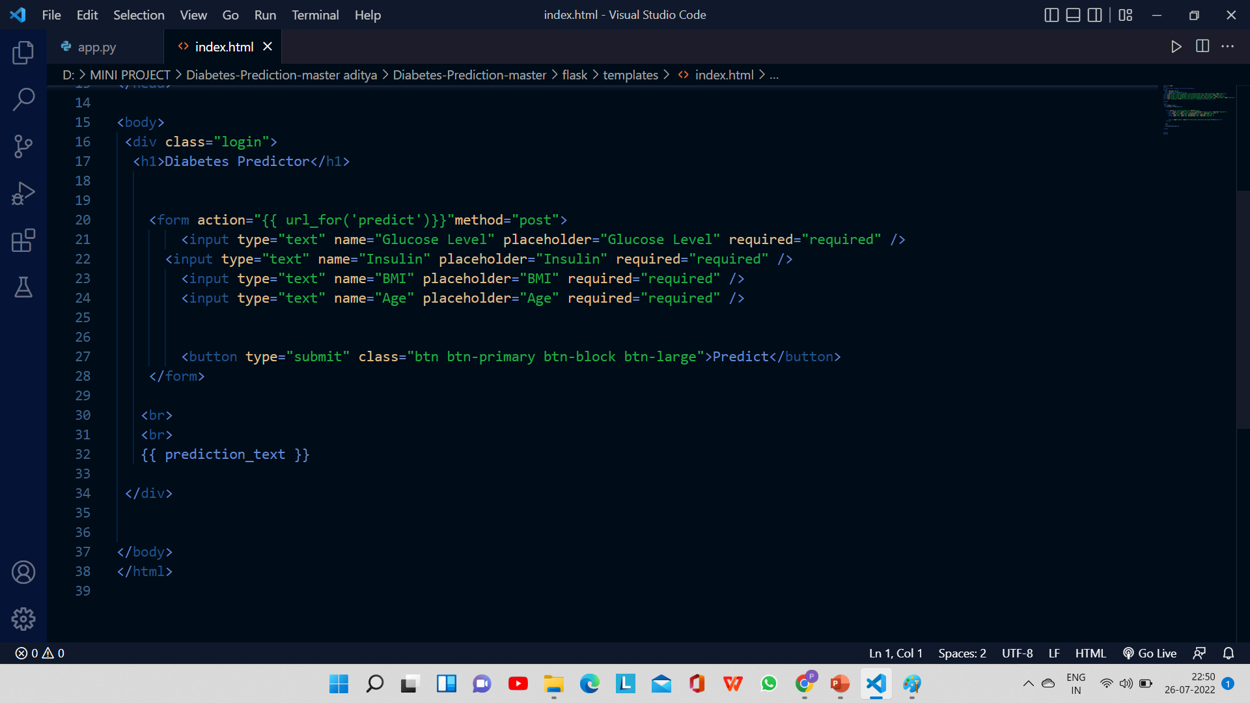

Slide 24
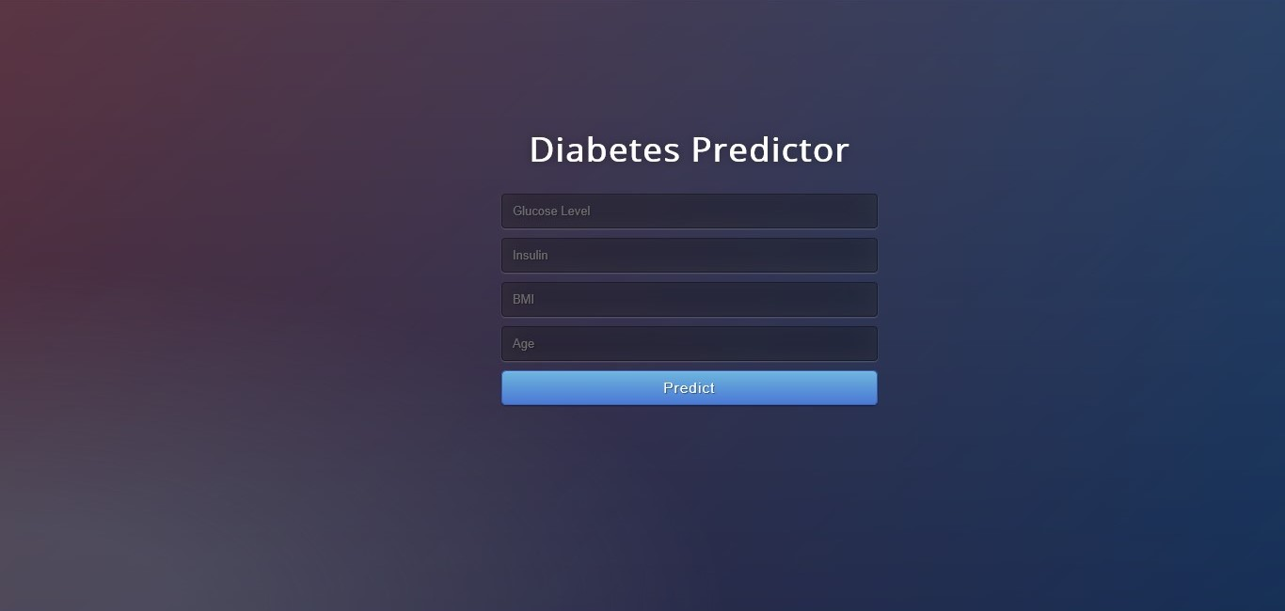
OUTPUT :

Slide 25
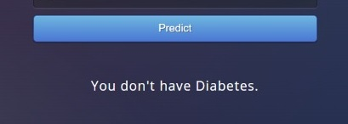
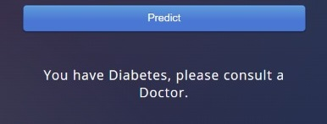
FINAL OUTPUT

Slide 26
CONCLUSION:
Diabetes is a slow killer with no known curable treatments. However, its complications can be
reduced through proper awareness and timely treatment. Three major complications are related
to blindness, kidney damage and heart attack. It is important to keep the blood glucose levels of
patients under strict control for avoiding the complications. One of the difficulties with tight
control of glucose levels in the blood is that such attempts may lead to hypoglycemia that creates
much severe complications than an increased level of blood glucose. Researchers now look for
alternative methods for diabetes treatment. The goal of this paper is to give a general idea of the
current status of diabetes research. The author believes that diabetes is one of the highly
demanding research topics of the new century and wants to encourage new researchers to take up
the challenges.

Slide 27
REFERENCES:
https://www.frontiersin.org/articles/10.3389/fgene.2018.00515/full
• https://www.hindawi.com/journals/jhe/2021/9930985/
• I Support Vector Machine:December 20, 201 by Funny Notebooks (Author)
• Support Vector Machines Machine Learning: Notebook Planner - 6x9 inch Daily Planner Journal,
To Do List Notebook, Daily Organizer, 114 Pages Paperback – May 18, 2022 by TYWANDA
LIMON (Author)
• https://doi.org/10.3389/fgene.2018.00515

Slide 28
THANK YOU
.

